Slide 1


SMART DUSTBIN
An Innovation by
Biomedical Engineers

Slide 2
INTRODUCTION
As a Biomedical Engineers we need to provide the solutions for the person with disabilities, to reduce the work of the Doctor by assisting them with devices which can make the work easier. One such device is SMART DUSTBIN.
Smart Dustbin is an innovative project which can be used in Health Care Sector.
By using this, Surgeons can put the med-waste in the dustbin by hands-free at the time of surgery. In addition to this the person with disability can also throw the waste inside the dustbin without making contact with it.

Slide 3
WORKING
The Ultrasonic sensor is mounted on the top of the dustbin. It sends out high-frequency sound waves that bounce off any object in their path and return to the sensor.
The Servo motor is connected inside the dustbin, if an object is sensed by ultrasonic sensor then the servo motor is activated and it starts spinning.
The Arduino board is programmed to detect the object using the ultrasonic sensor. When the object is detected, the servo motor is activated, which opens the lid of the dustbin.

Slide 4
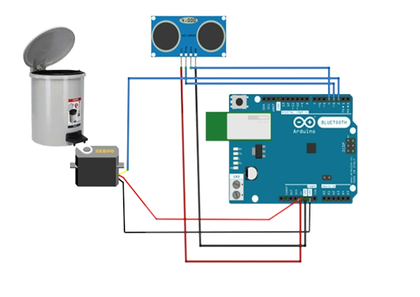
CIRCUIT DIAGRAM
Ultra Sonic Sensor
Dustbin
Arduino Board
Power Supply

Slide 5

FEATURES
Automatic Lid Opening: The ultrasonic sensor can detect the presence of waste in the dustbin, and the servo motor can open the lid automatically to facilitate waste disposal.
Power Management: The Arduino board can also be used to optimize power management, putting the system to sleep when not in use to conserve power.
Easy Maintenance: The use of an Arduino board and ultrasonic sensor can make maintenance easy, as they are readily available and easily replaceable.
Hygiene Care: By using the smart dustbin the wastes are collected without touching the hands on the dustbin

Slide 6
MAIN PURPOSE
Helping Disabled Person: This Smart dustbin can be used by the persons with disability where they no need to make contact with the dustbin to open the lid. The sensor will automatically detect the object and the lid will open.
Improved hygiene: Smart dustbins can help to improve hygiene by reducing the need for physical contact with the bin. With the automated lid opening and closing, users do not need to touch the bin, which can help to reduce the spread of germs.
Cost-effective: The use of an Arduino board, servo motor, and ultrasonic sensor in a smart dustbin is relatively cost-effective. The Arduino board is an open-source platform, and the other components are readily available and affordable, making it an accessible solution for waste management.
Energy-efficient: The ultrasonic sensor used in the smart dustbin helps to conserve energy as it only activates the servo motor when it detects the presence of waste. This can help to reduce the overall energy consumption of the smart dustbin.

Slide 7

END OF THE PRESENTATION
TEAM MEMBERS
JAWAHAR U R
HARIHARAN C
Having any doubts? Feel free to ask us!

